Slide 1
OpenGL-Rendering Pipeline

Slide 2
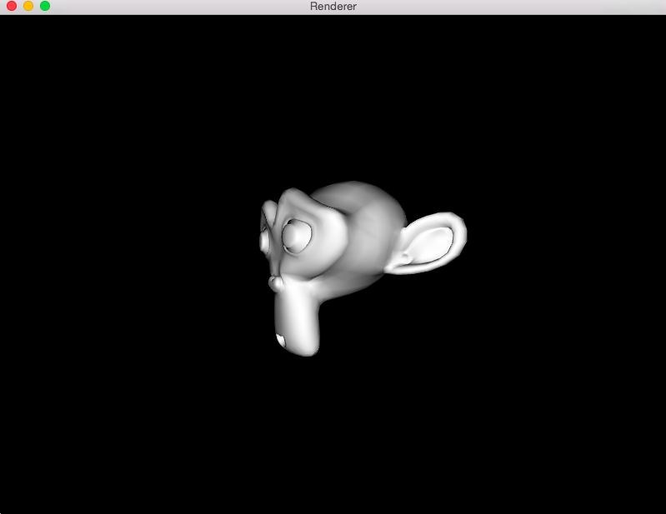

Slide 3

OpenGL
Created in 1991 by Silicon Graphics. Now it is managed by the Khronos consortium
A library of functions (e.g., glDrawArrays) and constants (e.g., GL_TRIANGLES)
The API interacts with the graphics processing unit (GPU)
Language-independent: has many bindings, e.g., WebGL.
Platform-independent: works on Win/Linux/..

Slide 4
OpenGL – Libraries
OpenGL doesn’t support input or windowing
GLUT (or GLFW) is used to create a context
Platform-dependent extensions can be provided by vendors. Identified by ARB, EXT, ..
GLEW wraps the extraction of functionality

Slide 5
OpenGL – History
OpenGL 1 (1992): Fixed pipeline
OpenGL 2 (2004): Programmable shaders (GLSL)
OpenGL 3: Deprecated the fixed functionality
OpenGL 3.1 (2009): Removed completely the fixed pipeline
..
OpenGL 4.5 (2014):
Notes:
最初這個功能是以組合語言撰寫著色器來達到的。組合語言對開發者的使用是不直觀而複雜的。OpenGL ARB 建立了 OpenGL 著色語言，為 GPU 的程式設計提供更加直觀的方法，當維護開放標準的時候，就有助於帶動 OpenGL 的歷史。
最初 OpenGL 1.5 是以擴充形式引入，後來 OpenGL ARB 在 OpenGL 2.0 核心中正式納入 GLSL。自 1992 年建立的OpenGL 1.0 起，OpenGL 2.0 是第一個 OpenGL 的大修改版。
使用 GLSL 有如下好處：
具有跨平台的相容性，包括 Macintosh、Windows 和 Linux 等作業系統。
所有支援 OpenGL 著色語言的繪圖卡，都可以用來編寫著色器。
允許廠商為特定的繪圖卡產生最佳化的代碼。

Slide 6
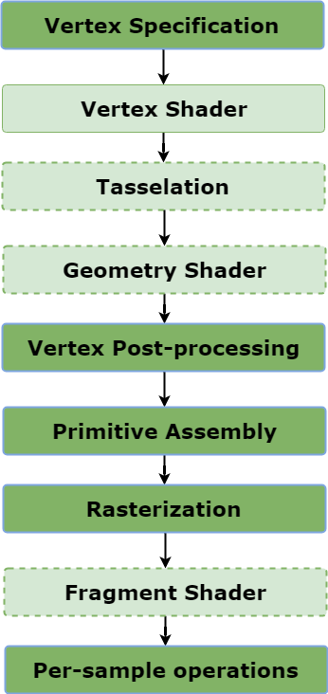
OpenGL-Rendering Pipeline

Slide 7
OpenGL-Rendering Pipeline

Slide 8
OpenGL-Rendering Pipeline
List an ordered list of vertices that define
1.The boundaries of the primitive (Points, Lines or Polygons).
2.Colors of each vertices.
3.Texture coordinates.

Slide 9
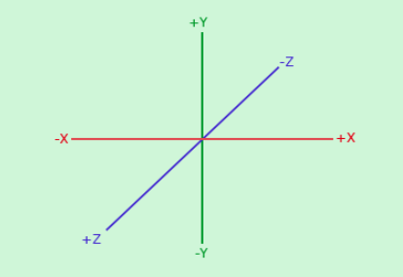
OpenGL 3D Coordinate

Slide 10
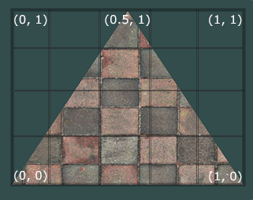
Texture Coordinate

Slide 11
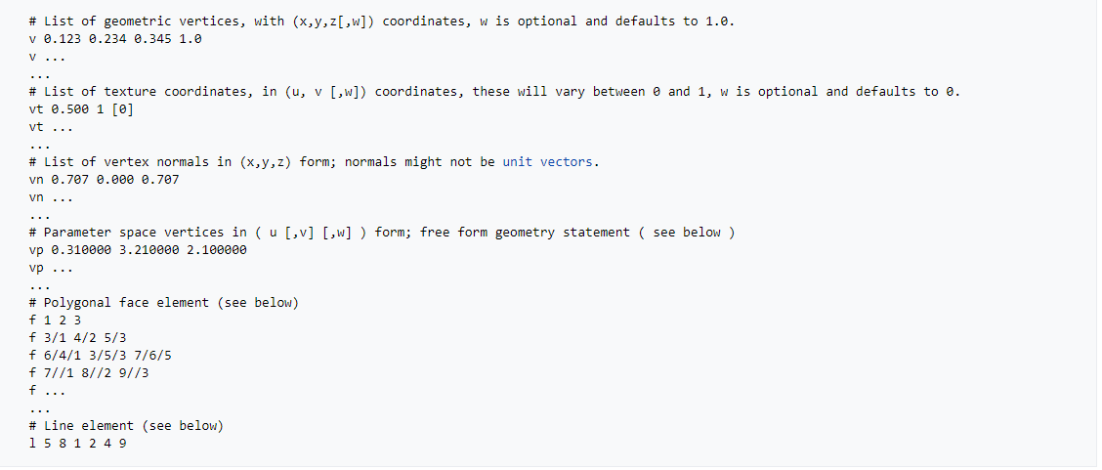
Vertex specification
Common object format: .obj, .stl, .3ds
You can obtain free 3D model from CGTrader or you can make it by yourself using Blender.
Notes:
f vertex/uv/normal

Slide 12
OpenGL-Rendering Pipeline
Vertex Shader is a program written in GLSL that manipulate the vertex data.
The goal of vertex shader is to calculate final vertex position of each vertex.

Slide 13
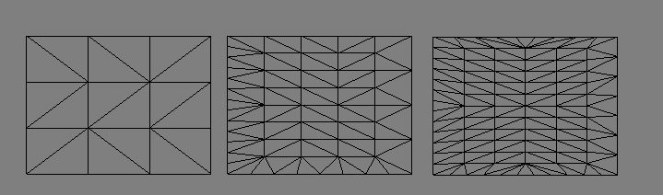
OpenGL-Rendering Pipeline
This shader stage is optional.
Divided into smoother mesh of triangles.

Slide 14
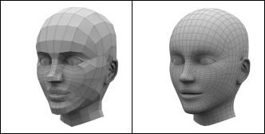
OpenGL-Rendering Pipeline
This shader stage is optional.
Divided into smoother mesh of triangles.

Slide 15
OpenGL-Rendering Pipeline
This shader stage is optional.
Convert primitives to different types.
For example, point primitive can become triangles.

Slide 16
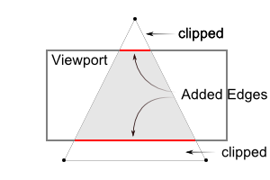
OpenGL-Rendering Pipeline
This is a fixed function stage.
The most important part of this stage is Clipping.

Slide 17
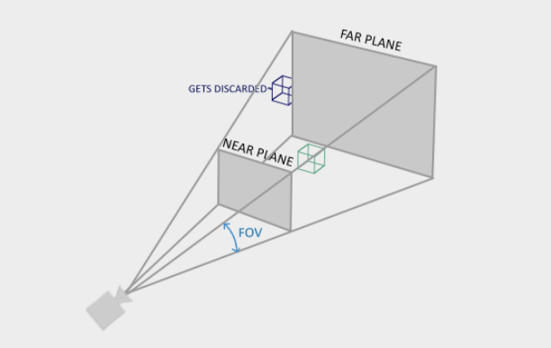
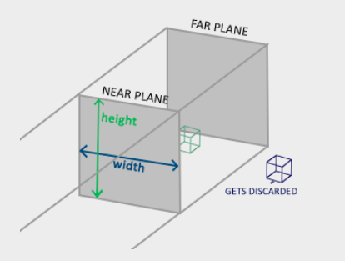
Perspective and Orthogonal rendering

Slide 18
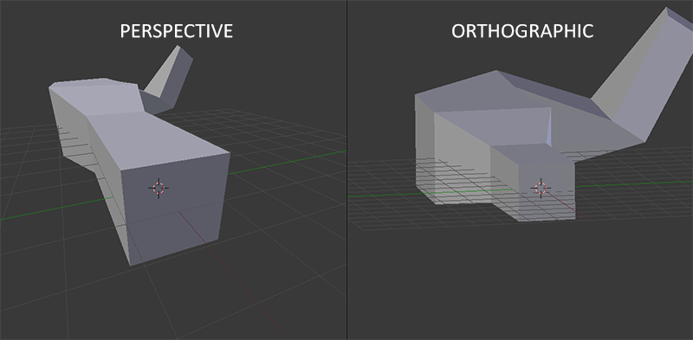
Perspective and Orthogonal rendering

Slide 19
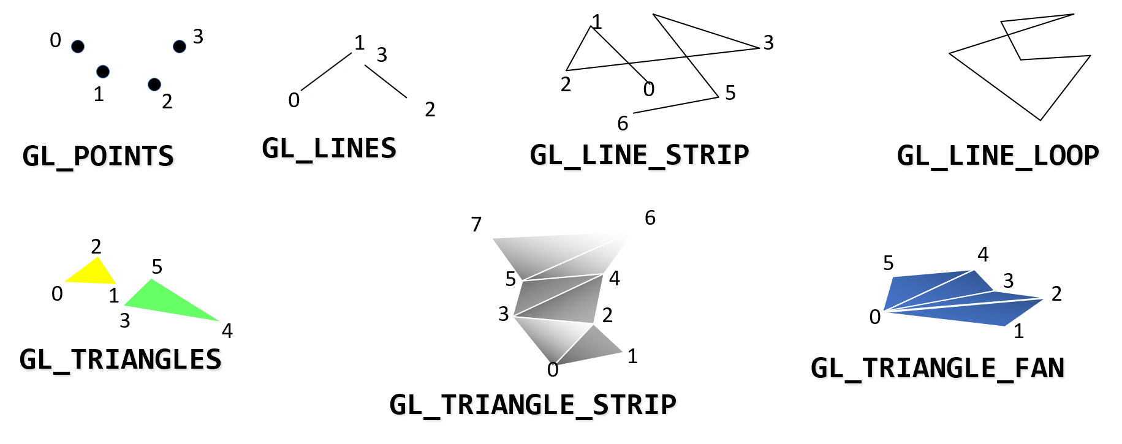
OpenGL-Rendering Pipeline
This stage collects the vertex data into a ordered sequence of simple primitives(lines, points or triangles).

Slide 20
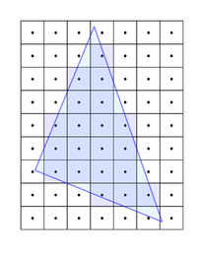
OpenGL-Rendering Pipeline
The output of rasterization is a fragments.

Slide 21
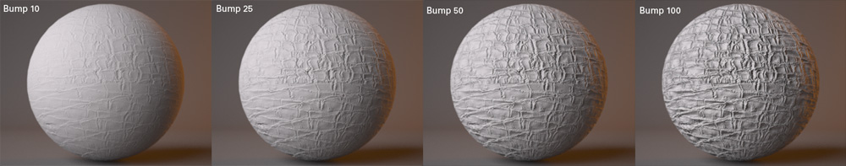
OpenGL-Rendering Pipeline
User-written program in GLSL calculates the color of each fragment that user sees on the screen.
Bump mapping

Slide 22
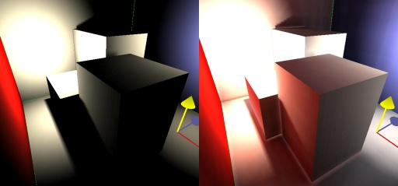
OpenGL-Rendering Pipeline
User-written program in GLSL calculates the color of each fragment that user sees on the screen.
Global illumination

Slide 23
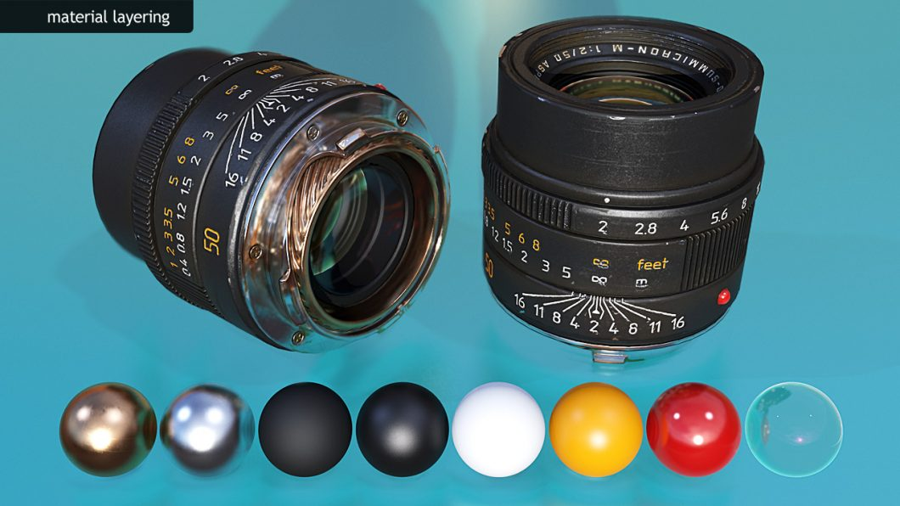
OpenGL-Rendering Pipeline
User-written program in GLSL calculates the color of each fragment that user sees on the screen.
Physically based rendering

Slide 24
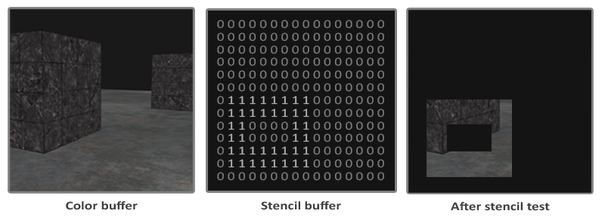
OpenGL-Rendering Pipeline
There are few tests that are performed based on user has activated them or not.
For example:
  Pixel ownership test, Scissor Test, Stencil Test, Depth Test.

Slide 25
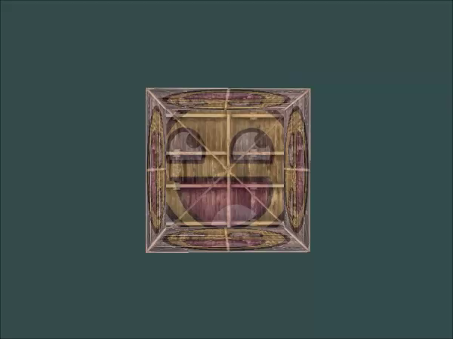
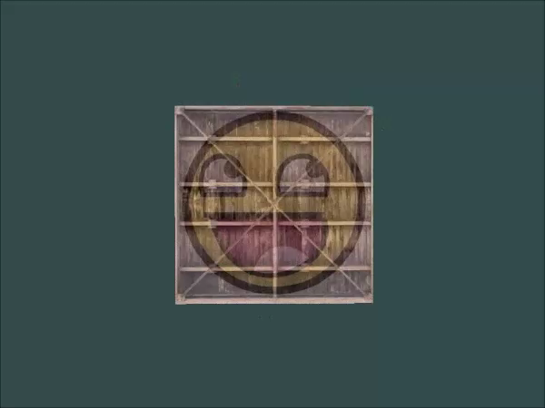
OpenGL-Rendering Pipeline
There are few tests that are performed based on user has activated them or not.
For example:
  Pixel ownership test, Scissor Test, Stencil Test, Depth Test.

Slide 26
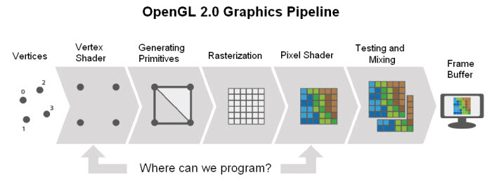
OpenGL-Rendering Pipeline
Where we can program!

Slide 27
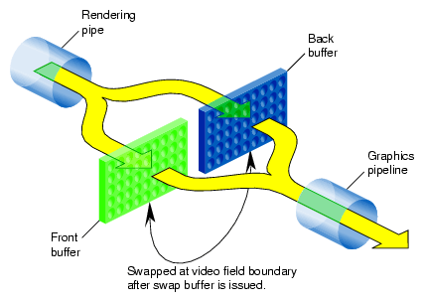
Double-Buffered Animation

Slide 28
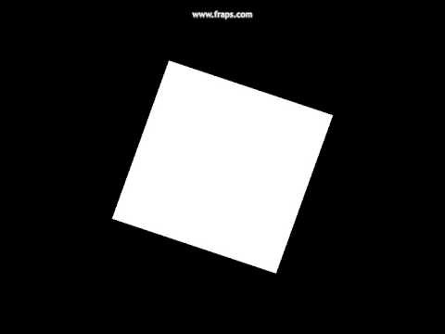
Single Frame Buffer

Slide 29

Double Frame Buffer

Slide 30
New OpenGL vs Old OpenGL
New version uses GLFW (or GLAD) : Old version uses GLUT (freeGLUT)
New version has implementable shader : Old Version does not.
New version can render scene when ever you want. Old version has fixed pipeline.

